Slide 1
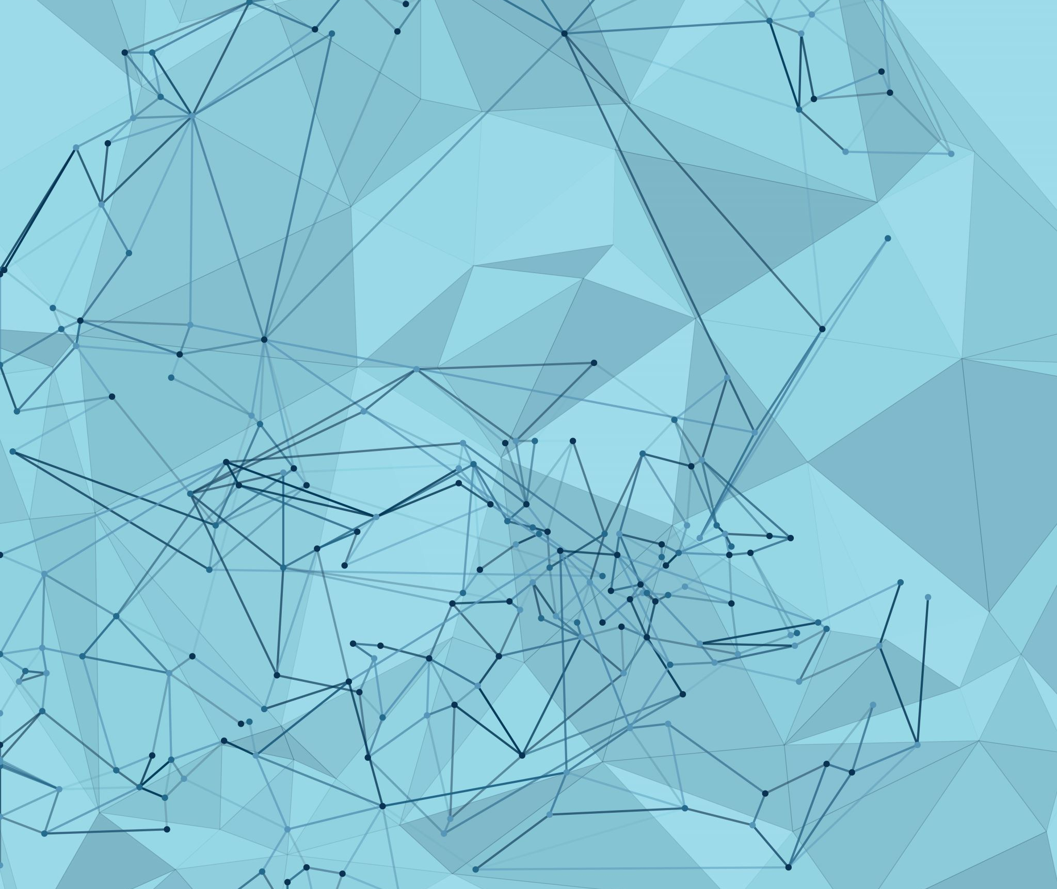
Disaster Recovery in Cloud Environments
Introduction to Cloud Computing
Backup Strategies, RPO/RTO, and Azure DR Solution

Slide 2
Lecture Objectives
Understand key disaster recovery (DR) concepts in cloud computing.
Define and distinguish Recovery Point Objective (RPO) and Recovery Time Objective (RTO).
Explore various backup strategies used in the cloud.
Learn how to configure disaster recovery solutions in Microsoft Azure.

Slide 3
What is Disaster Recovery (DR)?
Definition:
📌 A set of policies, tools, and procedures to restore vital infrastructure and systems after a disruption.
Why It Matters: Minimizes downtime and data loss from:
🔹 System failure
🔹 Cyberattacks
🔹 Natural disasters
🔹 Human error
💡 Cloud providers offer scalable and automated DR capabilities.

Slide 4
Key Metrics – RPO & RTO
📌 Cloud pricing varies based on geography!
🧠 Lower RPO/RTO = Higher cost due to faster recovery infrastructure.
Metric | Definition | Example
RPO (Recovery Point Objective) | Maximum acceptable amount of data loss measured in time. | "We can afford to lose up to 15 minutes of data."
RTO (Recovery Time Objective) | Maximum acceptable time to restore services. | "The system must be back online within 1 hour."

Slide 5
Common Backup Strategies
✅Full Backup – Copies entire system/data (slow but comprehensive).
✅Incremental Backup – Only backs up changes since last backup (fast and efficient).
✅Differential Backup – Backs up changes since last full backup.
✅Snapshot-Based Backup – Rapid, point-in-time backups (used in cloud environments).
✅Geo-Redundant Storage (GRS) – Replicates data to a secondary Azure region for disaster protection.

Slide 6
Disaster Recovery Tiers in the Cloud
Tier | Strategy | Description
Tier 1 | Manual Backups | Periodic snapshots and exports
Tier 2 | Automated Backups | Scheduled with policies (e.g., Azure Backup Vault)
Tier 3 | Active-Passive | Standby infrastructure activated during a disaster
Tier 4 | Active-Active | Fully mirrored infrastructure across regions
⚙️ Azure Site Recovery supports active-passive failover scenario

Slide 7
Disaster Recovery in Azure
✅ Azure Backup
Backs up VMs, files, databases.
Centralized backup management.
✅ Azure Site Recovery (ASR)
Replicates workloads across regions.
Supports auto-failover and failback.
✅ Azure Storage Redundancy Options
Locally Redundant (LRS), Zone Redundant (ZRS), Geo-Redundant (GRS), Read-Access Geo-Redundant (RA-GRS).
📌 Most services can be configured for geo-replication and failover.

Slide 8
Example DR Scenario in Azure
Scenario: A mission-critical web application must recover from a regional failure.
🔹 Primary Region: East US
🔹 Backup Region: Central US
🔹 Azure Configuration:
Azure Backup enabled for VMs and databases.
Azure Site Recovery configured for VM replication.
Storage accounts use GRS for redundancy.
Application Gateway uses Traffic Manager for regional failover.
Activity: Hands-on Cost Optimization
📸 Architecture diagram and screenshots can be included in class demo or lab.

Slide 9
Best Practices for Cloud DR
✅ Define RPO/RTO for each workload.
✅ Regularly test recovery procedures (runbook testing).
✅ Monitor DR configurations using Azure Monitor & Alerts.
✅ Tag critical resources for backup and replication.
✅ Document and automate DR workflows (ARM templates, Bicep, or Terraform).

Slide 10
Summary
📌 DR is a critical component of cloud strategy.
✅ Azure provides multiple DR tools: Backup, ASR, GRS, RA-GRS.
📌 Understand trade-offs between cost, speed, and complexity.
✅ Plan, automate, and test your DR plan regularly.

Slide 11
Questions?

